Slide 1
Web Design with HTML and CSS
Chapter 7

Slide 2
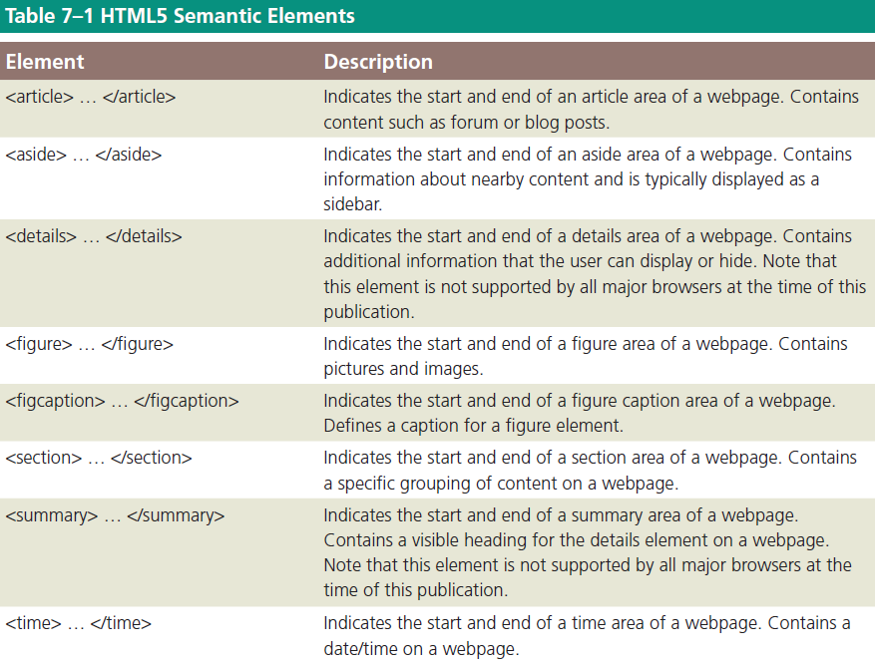
Using HTML5 Semantic Elements

Slide 3
Article Element
The article element, as described by the W3C, is
a complete, self-contained composition in a document, page, application, or site
independently distributable or reusable, e.g. in syndication
The start and end tags of article elements are <article> and </article>
Content placed between these tags will appear on a webpage as part of the article element

Slide 4
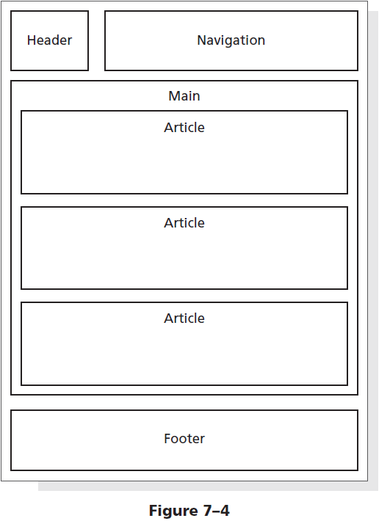
Article Element
Articles may be nested within other HTML elements, such as the main element, the section element, or other article elements
Articles are commonly used to contain news articles, blog and forum posts, or comments

Slide 5
Aside Element
The aside element is used as a sidebar that contains additional information about a particular item mentioned within another element
For example, if an article on a webpage contains a recipe and a list of ingredients, one could include an aside element with more information about one of the key ingredients, such as its origin or where to purchase it
It can be nested within article elements or within main or section elements

Slide 6
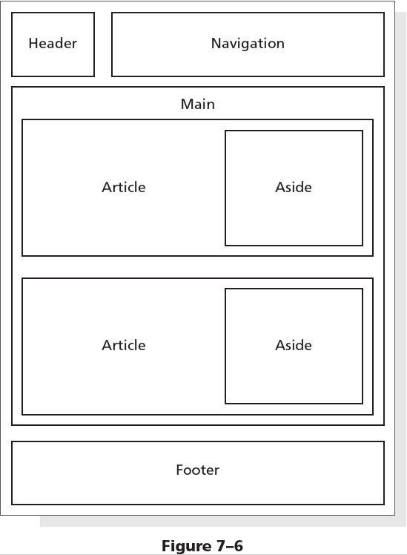
Aside Element

Slide 7
Section Element
The section element, as described by the W3C, is an element that
represents a generic section of a document or application. Here, a section is a thematic grouping of content. The theme of each section should be identified as a child of the section element
is not a generic container element. A general rule is that the section element is appropriate only if the element’s contents would be listed explicitly in the document’s outline

Slide 8
Section Element
The following is an example of a several section elements nested within an article element
<article>
<h1>Tutorials: Cooking Basics</h1>
<p>Watch our tutorials to learn the basics of good cooking.</p>
<section>
<h1>Tutorial 1</h1>
<p>Assembling basic kitchen tools.</p>
</section>
…
</article>

Slide 9
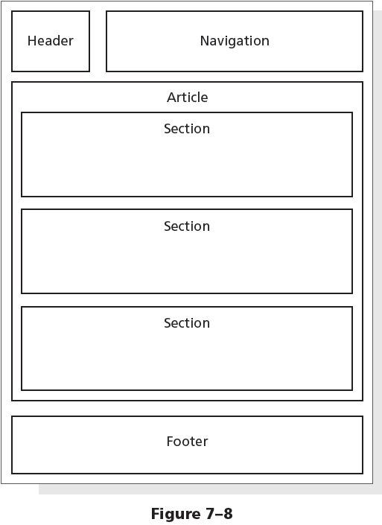
Section Element

Slide 10
Figure and Figure Caption Elements
The figure element is used to group content, such as illustrations, diagrams, and photos
According to the W3C, the figure element represents some flow content that is self-contained and is typically referenced as a single unit from the main flow of the document
A figure element can contain one or more img elements

Slide 11
Figure and Figure Caption Elements
The figure element may contain an optional figure caption element, which is used to provide a caption for the figure element
The start and end tags of the figure caption element are <figcaption> and </figcaption>

Slide 12
Figure and Figure Caption Elements
The following is an example of the figure element and the figure caption element
<figure>
<figcaption>New York City Highlights</figcaption>
<img src="ny1.jpg" alt="Statue of Liberty">
<img src="ny2.jpg" alt="Central Park">
<img src="ny3.jpg" alt="New York at Night">
</figure>

Slide 13
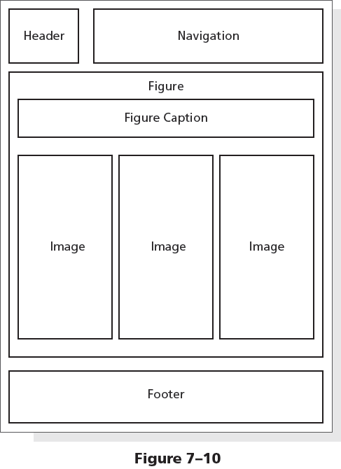
Figure and Figure Caption Elements

Slide 14
Website Layout
A banner is a graphic that spans the width of a webpage and usually brands a website, often by displaying its name or an identifying image
The CSS3 opacity property specifies the transparency of an element
The text-shadow property applies a shadow to text
h-shadow value – designates the horizontal position of the shadow
v-shadow value – designates the vertical position of the shadow

Slide 15
Website Layout
An example of a style rule that applies a text shadow to an element is shown below
h1 {
text-shadow: 0.2em 0.1em #292933;
}
In this example, a text shadow with a horizontal position of 0.2em, a vertical position of 0.1em, and a dark gray color is applied to an h1 element

Slide 16
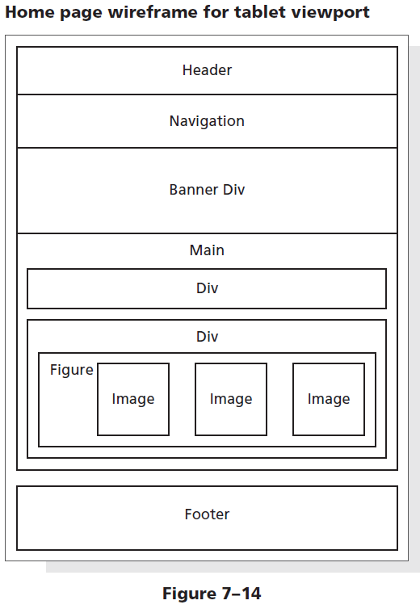
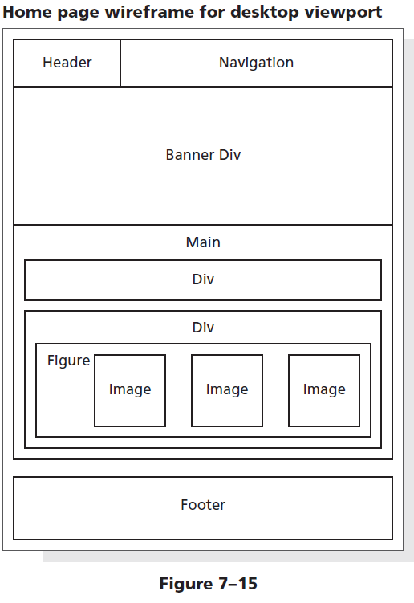
Redesigning the Home Page

Slide 17
Copy and Paste Data Files for Chapter 7
In the “WA100 Data Files” folder, click on the “chapter07” sub-folder.
Click on the “fitness” folder to show a series of image files (and a text file). COPY these files.
Navigate to the root directory “fitness” that was created for class. Then click onto the “images” folder.
PASTE the copied files into this folder. If you are prompted to replace the existing “ffc_logo.png” file, select the option to replace the file.

Slide 18
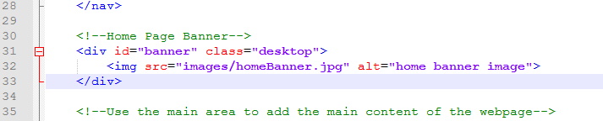
Adding a New div Element to the Home Page
Open the “index.html” file in Notepad++
Click at the end of Line 28 and press ENTER twice to insert new Lines 29 and 30.
Enter the code which will create a new div element to contain the banner image for the website.

Slide 19
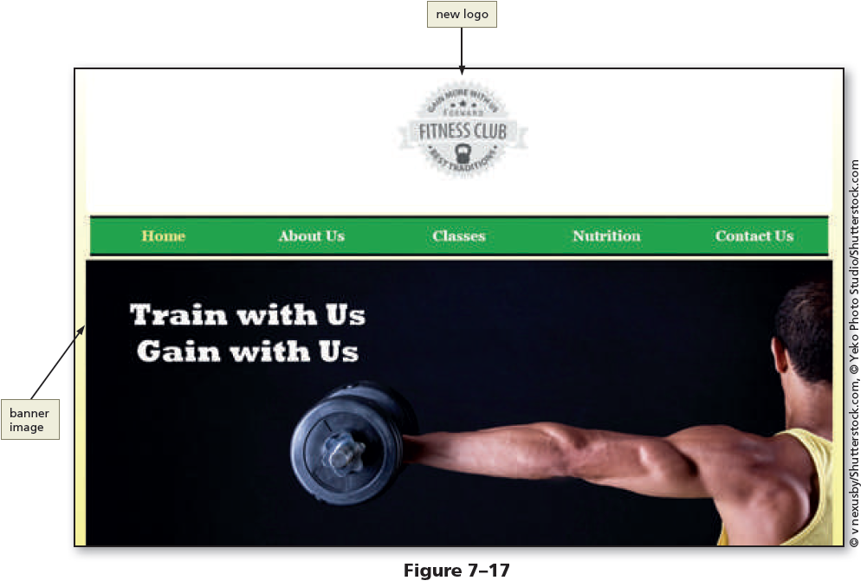
Adding a New div Element to the Home Page

Slide 20
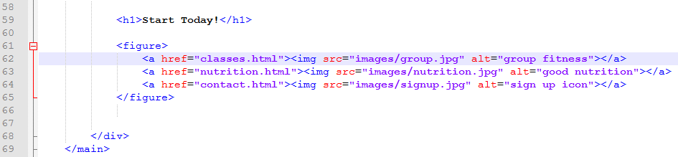
Adding a figure Element to the Home Page
Click at the end of Line 57 and press ENTER twice to insert new Lines 58 and 59.
Enter the code which will insert a figure element. This will contain 3 new images and links using the figure element to group them together.

Slide 21
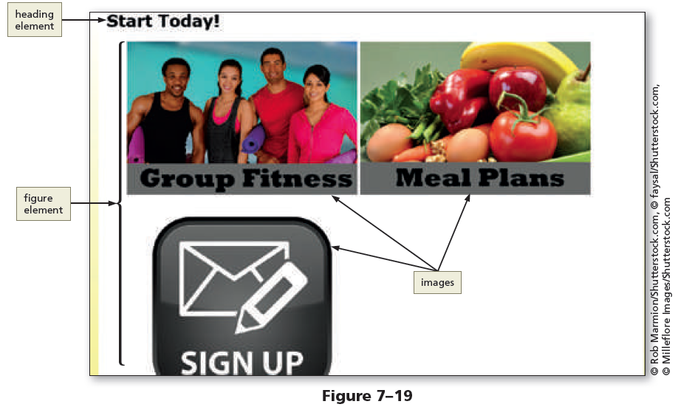
Adding a figure Element to the Home Page

Slide 22
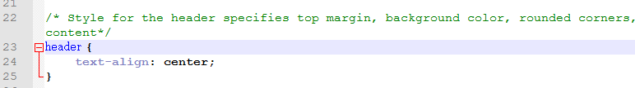
Update the Style Sheet for the New Design in a Mobile Viewport
Open the “styles.css” file in Notepad++
On Line 5, replace the background-color value with 1D1D1C to modify it to dark gray.
Remove Lines 24 through 26, then press DELETE so that the text-align property and value are on Line 24.

Slide 23
Update the Style Sheet for the New Design in a Mobile Viewport
Click at the end of Line 32 and press ENTER to insert a new Line 33.
On Line 33, type ” margin-top: -1.5em “ this negative value will place the top margin of the nav element within the area of the header element.
On Line 45, replace the background-color value with 9D9D93 to modify it to light gray.

Slide 24
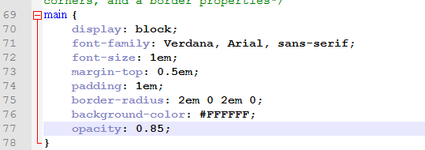
Update the Style Sheet for the New Design in a Mobile Viewport
On Line 75, replace the border-radius value with 2em 0 2em 0 to modify it (This will round the top-left and bottom-right corners and square the others).
Remove Lines 77 & 78 to delete those values.
On Line 77, type opacity: 0.85; to make the main element 85% transparent.

Slide 25
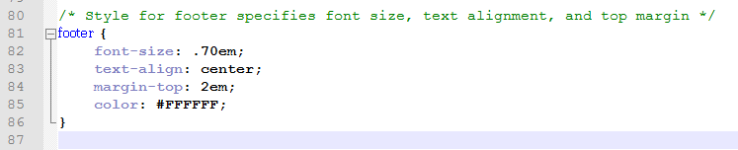
Update the Style Sheet for the New Design in a Mobile Viewport
Click at the end of Line 84 and press ENTER to insert a new Line 85.
On Line 85, type color: #FFFFFF; to insert a color property and value of white. (This will change the footer text color to something more visible while in tablet and mobile viewports where the background is now a dark color.)

Slide 26
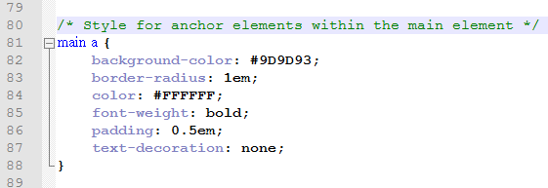
Add New Style Rules for Anchor Elements in a Mobile Viewport
Click at the end of Line 78 and press ENTER twice to insert new Lines 79 and 80.
Enter the code shown to update the style of the anchor element to be consistent with the new look of the website.

Slide 27
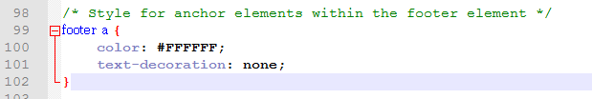
Add New Style Rules for Anchor Elements in a Mobile Viewport
Click at the end of Line 96 and press ENTER twice to insert new Lines 97 and 98.
Enter the code shown to update the style of the footer element.

Slide 28
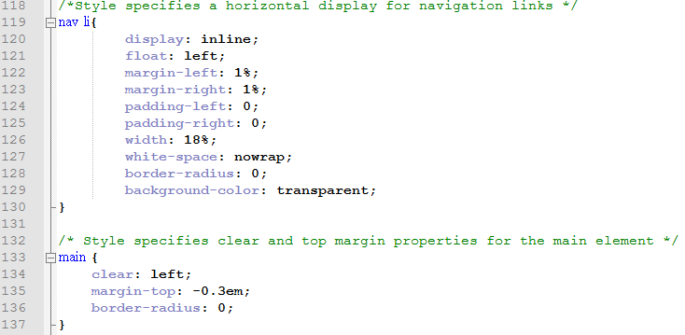
Update the Style Sheet for the New Design in a Tablet Viewport
Click at the end of Line 127 and press ENTER to insert a new Line 128.
Enter the code below to refine the styles in the nav and main elements for the tablet viewport.

Slide 29
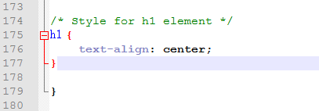
Adding New Style Rules to the Tablet Viewport
Click at the end of Line 172 and press ENTER twice to add new Lines 173 & 174.
Enter the comment and code below which will center-align the H1 element in a tablet viewport.

Slide 30
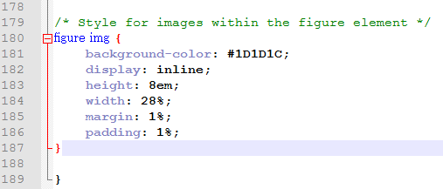
Adding New Style Rules to the Tablet Viewport
Press the ENTER key twice to insert new Lines 178 & 179.
Enter the comment & code below to create a new style rule for the images within the figure element.

Slide 31
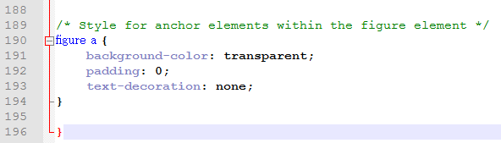
Adding New Style Rules to the Tablet Viewport
Press the ENTER key twice to insert new Lines 188 & 189.
Enter the comment & code below to create a new style rule for the anchor elements within the figure element.

Slide 32
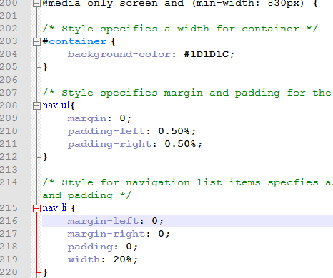
Update the Style Sheet for the New Design in a Desktop Viewport
On Line 204 of “styles.css”, remove the width property and value and then type background-color: #1D1D1C
Delete Lines 216 through 218.
If necessary, move the margin-left property and value up to Line 216.

Slide 33
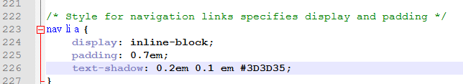
Update the Style Sheet for the New Design in a Desktop Viewport
Click at the end of Line 225 then press ENTER to insert a new Line 226.
On Line 226, type text-shadow: 0.2em 0.1em #3D3D35
(This is the position of the horizontal and vertical shadow and then the dark gray color for the shadow)

Slide 34
Update the Style Sheet for the New Design in a Desktop Viewport
On Line 235, replace the current color value with the value #CCCCFF; (very light blue).
On Line 239, replace the current color value with the value #9D9D93; (light gray).
Delete Lines 245 through 248.
On Line 245, type background-color: #1D1D1C;

Slide 35
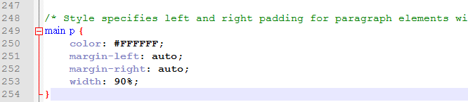
Update the Style Sheet for the New Design in a Desktop Viewport
DELETE lines 250 through 251.
On Line 250, type color: #FFFFFF as the new property and value.
Press ENTER to insert a new Line 251 and enter the code shown

Slide 36
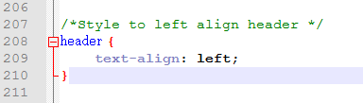
Add New Style Rules to the Desktop Viewport
In “styles.css” click at the end of Line 205 and press ENTER twice to insert Lines 206 and 207.
Enter the comment and code below which will be used to format the header and nav elements so that they appear side-by-side in desktop viewports.

Slide 37
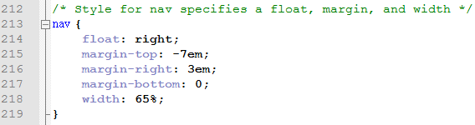
Add New Style Rules to the Desktop Viewport
Press ENTER twice to insert new Lines 211 & 212.
Enter the comment and code to push the navigation element up to be centered with the logo in the header.

Slide 38

Add New Style Rules to the Desktop Viewport
Click at the end of Line 268 and press ENTER twice to insert new Lines 269 and 270.
Enter the comment and code shown: (This will make the images in the figure element appear more transparent.)

Slide 39
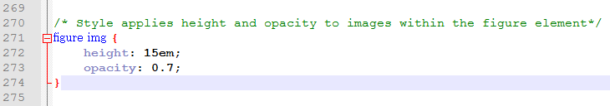
Update the Style Sheet for the New Design in a Desktop Viewport
DELETE lines 263 through 267.
On Line 263, type background-color: #FFFFFF;
Save changes, then refresh index.html in your browser (If needed, be sure to adjust the window to a desktop viewport size)
At the end of Line 268, press ENTER twice and enter the comment and code shown starting on Line 270.

Slide 40
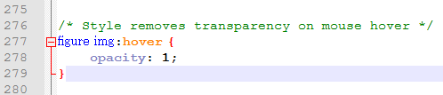
Update the Style Sheet for the New Design in a Desktop Viewport
Press the ENTER key TWICE to insert new Lines 275 & 276
Enter the comment and code shown below: (This will remove the opacity when the mouse hovers over an image in the figure element.)

Slide 41
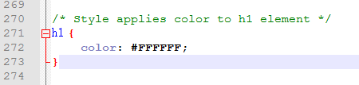
Update the Style Sheet for the New Design in a Desktop Viewport
Click at the end of Line 268 and press ENTER twice to insert new Lines 269 and 270.
Enter the comment & code shown: (This will change the color for the “Start Today” heading to a white color).

Slide 42
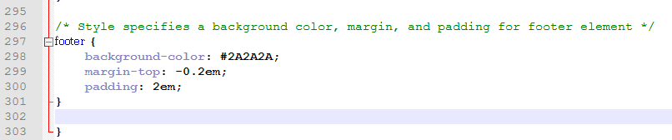
Update the Style Sheet for the New Design in a Desktop Viewport
Click at the end of Line 294 and press ENTER twice to insert new Lines 295 & 296.
Enter the comment & code shown: (This will modify the properties and values for the desktop viewport’s footer element.)

Slide 43
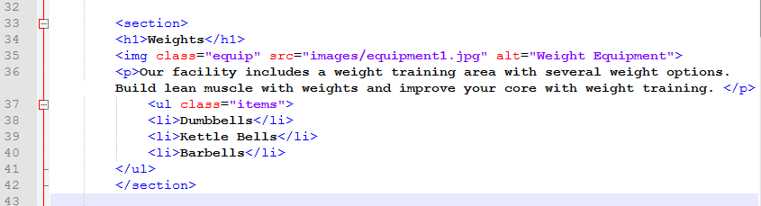
Adding Section Elements to the About Us Page
Open “about.html” in Notepad ++
Click after the <main> starting tag, and press ENTER to insert a new blank line.
Be sure to press TAB to increase the indent before adding the <section> element code shown:

Slide 44
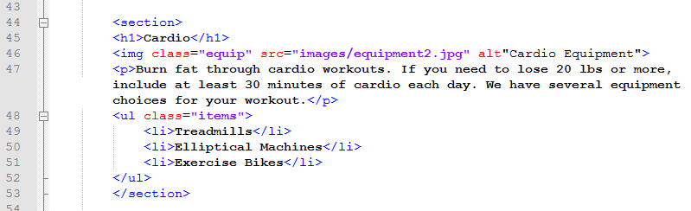
Adding Section Elements to the About Us Page
Click the blank line before the <h1>Cardio</h1> elements.
Press ENTER to insert a new line.
Enter the code shown to add the <section>element to this group of code.

Slide 45
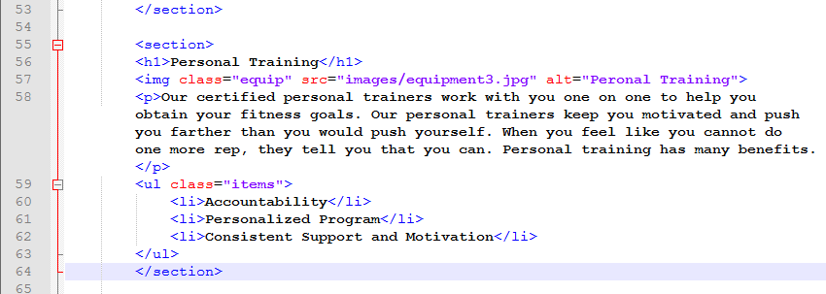
Adding Section Elements to the About Us Page
Click the blank line before the <h1>Personal Training</h1> elements.
Press ENTER to insert a new line.
Enter the code shown to add the <section>element to this group of code.

Slide 46
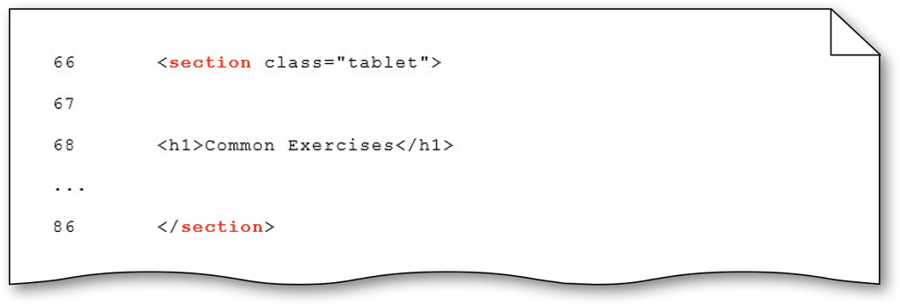
Adding Section Elements to the About Us Page
On Line 66, replace the word “div” with “section” to modify the tag.
On Line 86, modify the ending tag by replacing “div” with “section” as well.

Slide 47
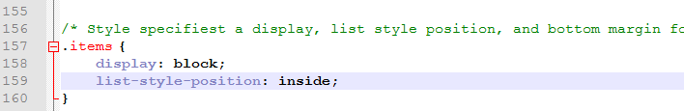
Styling the About Us Page for a Tablet Viewport
If needed, reopen “styles.css” files in Notepad ++
On Line 160, DELETE the “margin-bottom” property and move the closing brace to Line 160. (This will create additional space for the next few changes.)

Slide 48
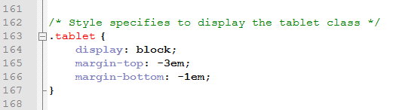
Styling the About Us Page for a Tablet Viewport
Click at the end of Line 164 and press ENTER to insert a new Line 165.
Enter the code shown below to add new margin properties and values.

Slide 49
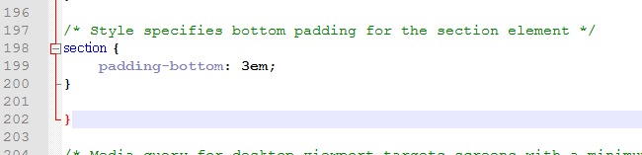
Styling the About Us Page for a Tablet Viewport
Click at the end of Line 195 and press ENTER twice to insert new Lines 196 and 197.
Enter the comment and code shown below:

Slide 50
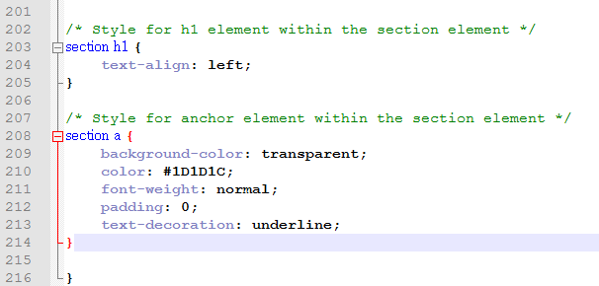
Styling the About Us Page for a Tablet Viewport
Press ENTER twice to insert new Lines 201 & 202.
Add the comments and code shown:

Slide 51
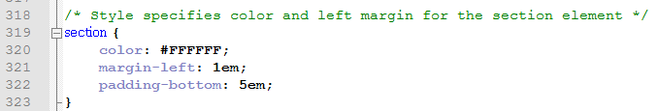
Styling the About Us Page for a Desktop Viewport
DELETE Lines 306 through 309 to remove the style rule for .items. (If needed, move the comment for the body element up to Line 306).
Click at the end of Line 316 and press ENTER twice to insert new Lines 317 & 318. Enter the comment and code shown:

Slide 52
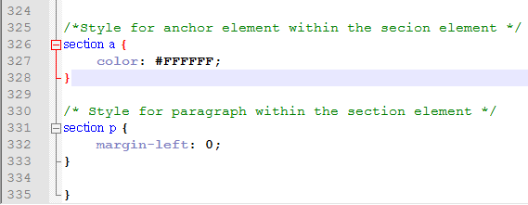
Styling the About Us Page for a Desktop Viewport
Press the ENTER key twice to insert new Lines 324 & 325.
Add the comments and code shown:

Slide 53
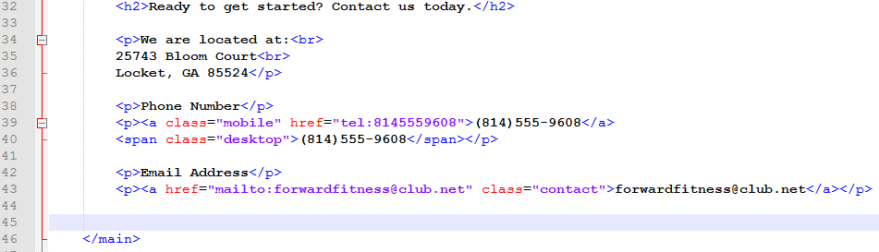
Updating the Contact Us Page
Open “contact.html” in Notepad ++
Click at the end of Line 38 (after “Phone Number) and replace the line break tag with a </p> to insert and ending paragraph tag.
Click at the beginning of Line 39 and insert a starting paragraph tag <p>
Click at the end of Line 42 and replace the line break tag with an ending paragraph tag </p>.
Click at the beginning of Line 43 and insert a paragraph tag <p>.
On Line 43, insert class=“contact” after the mailto address.
Delete the two line breaks on Line 44 <br><br>.

Slide 54
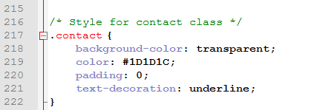
Styling the Contact Us Page
If needed, reopen “styles.css”
Click at the end of Line 214 and press ENTER twice to insert new Lines 215 & 216.
Enter the comment and code shown:

Slide 55
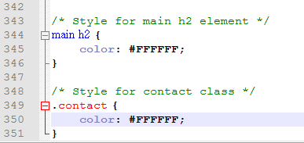
Styling the Contact Us Page
Click at the end of Line 341 and press ENTER twice to add new Lines 342 & 343.
Enter the comments and code shown:

Slide 56
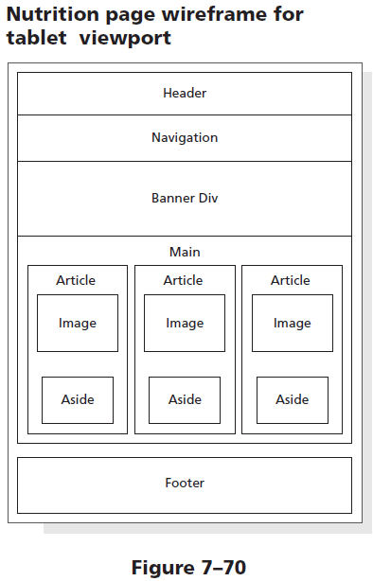
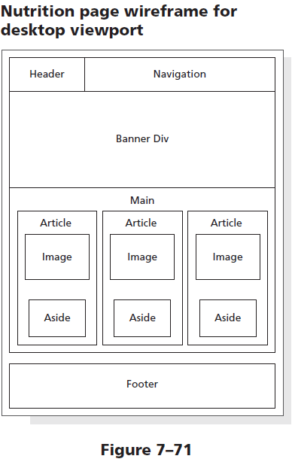
Creating the Nutrition Page

Slide 57
Creating the Nutrition Page
Open the template file we created “fitness.html” from the “Template” folder.
Click “FILE”, then “SAVE AS”, be sure to go UP one folder level so this new file can be saved in the main “Fitness” folder (don’t save in the “Template” folder.
Name this file “nutrition.html”.

Slide 58
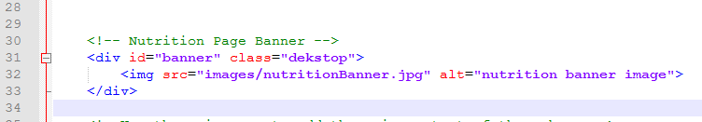
Creating the Nutrition Page
Click Line 28 and press ENTER twice to insert new Lines 29 and 30.
Insert the comment and code below to add a banner image to this new page.

Slide 59
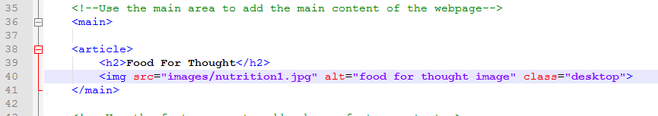
Creating the Nutrition Page
Click at the end of Line 36 and press ENTER twice to insert new Lines 37 & 38.
Insert an <article> tag on Line 38.
Enter the code shown to insert a new heading element and image element.

Slide 60
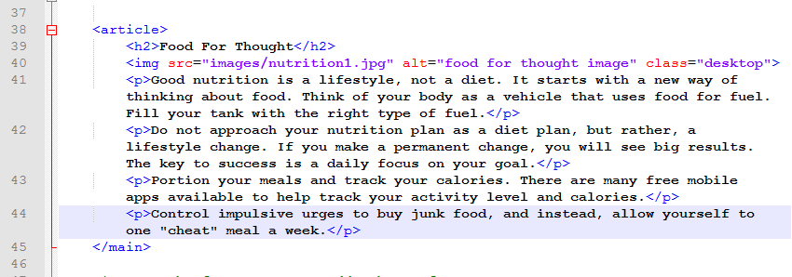
Creating the Nutrition Page
In Notepad ++, click OPEN, go into your “WA110_data_files” folder, then the “Chapter 7” folder.
In the “fitness” folder, open the file named “nutritionText.txt”.
Select lines 2 through 5 and COPY the text.
Click back on the “nutrition.html” tab in Notepad++.
Press ENTER to insert new Line 41, the PASTE
Clean up the indents on the pasted lines.

Slide 61

Creating the Nutrition Page
Click at the end of Line 44 and press ENTER to insert a new Line 45.
Insert an <aside> element and add the text shown, then add the closing </article> tag on Line 46.

Slide 62
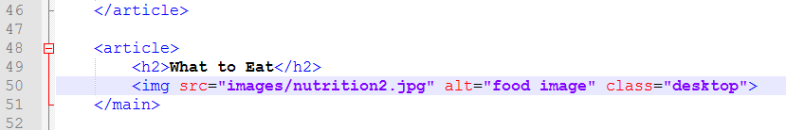
Creating the Nutrition Page
At the end of Line 46 and press ENTER to insert a new Line 47 & 48.
Insert another <article> element.
Press ENTER and then TAB to increase the indent. Add the <h2> element shown and then press ENTER to insert the <img> element shown on Line 50.

Slide 63
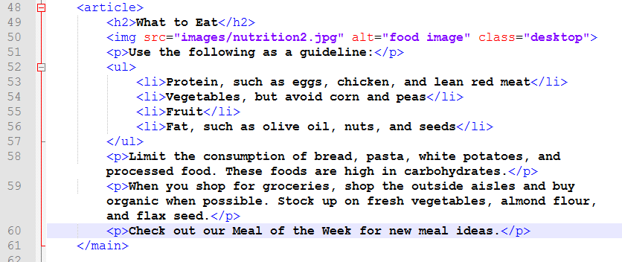
Creating the Nutrition Page
Click the tab containing the “nutritionText.txt” file.
Select lines 8 through 17 and COPY the text.
Click back on the “nutrition.html” tab in Notepad++.
Press ENTER to insert new Line 51, the PASTE
Clean up the indents on the pasted lines as shown.

Slide 64
Creating the Nutrition Page
Click at the end of Line 60 and press ENTER to insert a new Line 61.
Insert an <aside> element and add the text shown, then add the closing </article> tag on Line 62.

Slide 65
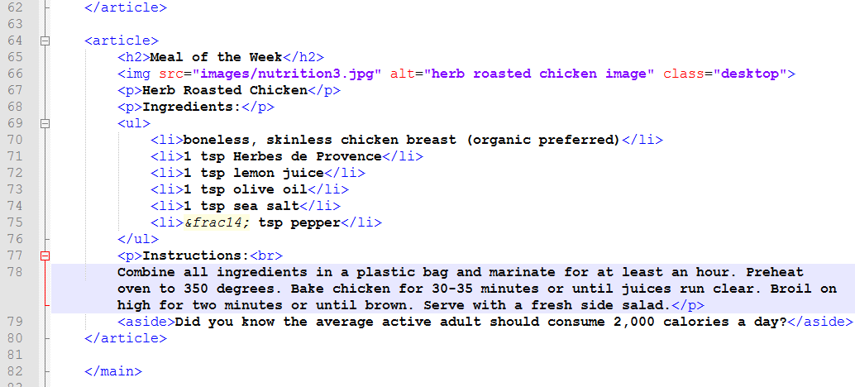
Creating the Nutrition Page
Press ENTER twice to insert Lines 63 & 64.
In the “nutrition.txt” file, copy Lines 20 through 31.
Following what we did for the previous two articles, add the code shown for the remaining article starting on Line 64. (Be sure to adjust indents as shown)

Slide 66

Style the Nutrition Page for a Mobile Viewport
Switch to the “styles.css” tab in Notepad ++
Click at the end of Line 112 and press ENTER twice to add new Lines 113 & 114.
Enter the comment and code shown to style the <aside> element.

Slide 67

Create a 3-Column Layout for the Tablet Viewport
Click at the end of Line 227 and press ENTER twice to insert new Lines 228 & 229.
Enter the comment and code shown to style the <article> elements into a 3-column format.

Slide 68

Creating the Nutrition Page
Overflow property – It is used to specify how to manage content when it “spills over” into another element

Slide 69

Creating a Three-Column Layout for the Nutrition Page in a Tablet Viewport
Overflow property – It is used to specify how to manage content when it “spills over” into another element

Slide 70
Applying the Overflow Property to the main Element Style Rule
The main element is not in the correct area in the previous screenshot.
The float property used within the article style rule displaces the main element to the banner image area.
To correct this issue, let’s apply an overflow property with a value of auto to the main style rule contained within the tablet media query.

Slide 71

Applying the Overflow Property to the main Element Style Rule
Click at the end of Line 141 and press ENTER to insert a new Line 142.
On Line 142 type the code for the overflow property as shown.
Refresh changes in your browser to see how the main element should now appear below the banner image.

Slide 72

Applying the Overflow Property to the main Element Style Rule

Slide 73

Styling the article Element for the Nutrition Page
Click at the end of Line 238 and press ENTER twice to insert new Lines 239 & 240.
Enter the comment and code shown which will center the article elements and add a border.

Slide 74

Styling the article Element for the Nutrition Page
Press ENTER twice to insert new Lines 246 & 247.
On Line 247, add the comment and code shown for the paragraph elements within the article element.

Slide 75
Styling the article Element for the Nutrition Page
Press ENTER twice to insert new Lines 254 & 255.
On Line 255, add the comment and code shown for the unordered lists within the article element.

Slide 76

Styling the aside Element for the Nutrition Page
At the end of Line 258, press ENTER twice to insert new Lines 259 & 260.
Enter the comment and code shown to style the <aside> element.

Slide 77

Style the article H2 for the Nutrition Page in a Desktop Viewport
Click at the end of Line 396 and press ENTER twice to insert new Lines 397 & 398.
Enter the comment and code to change the color for the <h2> element while in a Desktop Viewport.

Slide 78
To Validate Your Code
For the Style Sheet:
Go to http://jigsaw.w3.org/css-validator
Upload your “style.css” file.
For the HTML Files:
Go to http://validator.w3.org
Upload the HTML files you wish.

